Slide 1


Chapter 1 Understanding the Manager’s Job
Fundamentals of
MANAGEMENT
Core Concepts & Applications
Griffin Eighth Edition
.

Slide 2
Chapter Outline
An Introduction to Management
Kinds of Managers
Basic Management Functions
Fundamental Management Skills
The Science and the Art of Management
The Evolution of Management
The Importance of Theory and History
The Historical Context of Management
The Classical Management Perspective

Slide 3
Learning Objectives
After studying this chapter, you should be able to:
Define management,
describe the kinds of managers found in organizations, and
briefly explain the four basic management functions.
Justify the importance of history and theory to management and explain the evolution of management thought.
Discuss contemporary management issues and challenges.

Slide 4
Reference books
Koontz, O Donnel and Weilrich : Management
Griffin W. Ricky: Management,

Slide 5
What is Management
The decisions taken under time, budget and resources
Which one does the organization value more and why
Under what circumstances are difficult decisions undertaken.
Notes:
Management refers to the process of planning, organizing, directing, and controlling resources, including people, finances, and materials, in order to achieve specific goals and objectives. It involves making decisions, delegating tasks, and motivating employees to work towards common goals.

Slide 6

Quiz no 1Buy, Rent or Repair?
■
You wreck your car! And you absolutely need one to get
around
A wholesaler offers $2,200 for the wrecked car, and $4,700 if it is
repaired. The car’s standing mileage is 58,000 miles
Your insurance company offers $1,100 to cover the cost of the
accident
To repair the car costs $2,500
A newer second–hand car costs $10,000 with a standing mileage
of 28,000 miles
A part–time technician can repair the car for $1,300, but it takes a
month. In the meantime, you need to rent a car, which costs $500
per month.
❑
❑
❑
❑
❑
■
Question: What should you do?
11

Slide 7
Example: Buy, Rent or Repair?
■
You wreck your car! And you absolutely need one to get
around
❑
❑
❑
❑
❑
A wholesaler offers $2,000 for the wrecked car, and $4,500 if it is
repaired. The car’s standing mileage is 58,000 miles
Your insurance company offers $1,000 to cover the cost of the
accident
To repair the car costs $2,000
A newer second–hand car costs $10,000 with a standing mileage
of 28,000 miles
A part–time technician can repair the car for $1,100, but it takes a
month. In the meantime, you need to rent a car, which costs $400
per month.
■
Question: What should you do?
11

Slide 8
Example: Buy, Rent or Repair?
No panic! Apply the engineering economic analysis procedure.
Step 1: Define the problem
In this case, it is simple — you need a car!
Step 2: Develop alternatives
You have several options.
(A) Sell the wrecked car and buy the second-hand car. (Of course you would
not just dispose the wrecked car.)
(B) Repair the car and keep it.
(C) Repair the car, sell it, and then buy the second-hand car.
(D) Let the part-time technician repair the car and rent in the meantime.
Afterwards, keep the car.
(E) Let the part-time technician repair the car and rent in the meantime.
Afterwards, sell the car and buy the second-hand car.
12

Slide 9
Example: Buy, Rent or Repair?
Step 3: Develop prospective outcomes via cash flows
(A) Sell the wrecked car and buy the second-hand car. $2,000 + $1,000 –
$10,000 = –$7,000
(B) Repair the car and keep it. $1,000 – $2,000 = –$1,000
(C) Repair the car, sell it, and then buy the second-hand car. $1,000 – $2,000
+ $4,500 – $10,000 = –$6,500
(D) Let the part-time technician repair the car and rent in the meantime.
Afterwards, keep the car. $1,000 – $1,100 – $400 = –$500
(E) Let the part-time technician repair the car and rent in the meantime.
Afterwards, sell the car and buy the second-hand car. $1,000 – $1,100 – $400
+ $4,500 – $10,000 = –$6,000
13

Slide 10
Example: Buy, Rent or Repair?
Step 4: Use a consistent criterion
Let us just focus on your asset value immediately after the decision is made.
(We are ignoring other things, such as higher future insurance costs, resell
value of the second-hand car, etc.)
Step 5: Compare the alternatives
(A) Sell the wrecked car & buy the 2nd-hand car. $10,000 – $7,000 = $3,000
(B) Repair the car and keep it. $4,500 – $1,000 = $3,500
(C) Repair the car, sell it, and then buy the second-hand car. $10,000 – $6,500
= $3,500
(D) Let the part-time technician repair the car and rent in the meantime.
Afterwards, keep the car. $4,500 – $500 = $4,000
(E) Let the part-time technician repair the car and rent in the meantime.
Afterwards, sell the car and buy the second–hand car. $10,000 – $6,000 =
$4,000
14

Slide 11
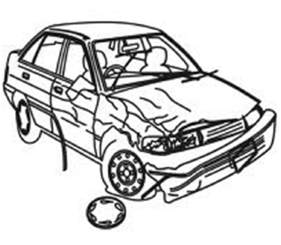

Example: Buy, Rent or Repair?
Step 6: Choose a preferred alternative after considering risk and uncertainties
From the asset value point-of-view, (D) and (E) are equally good. To
differentiate them, we need other criteria. Say, if the repaired car has a higher
risk of failing, then we would prefer (E).
Step 7: Revisit the decision
Road test the newer car and confirm your decision.
15

Slide 12
Four questions?
Who are managers?
What do managers do?
What is management?
Why study management?
Notes:
Overall, managers are responsible for ensuring that the organization is working effectively and efficiently towards its goals.

Slide 13
What is Management?
According to Ricky W. Griffin:
A set of activities
planning and decision making, organizing, leading, and controlling
directed at an organization’s resources
human, financial, physical, and information
with the aim of achieving organizational goals in an efficient and effective manner.
Notes:
5

Slide 14
Project Attributes
A project has distinctive attributes that distinguish it from ongoing work or business operations. Projects are temporary in nature.
They are not an everyday business process and have definitive start dates and end dates.
This characteristic is important because a large part of the project effort is dedicated to ensuring that the project is completed at the appointed time.
To do this, schedules are created showing when tasks should begin and end.
Projects can last minutes, hours, days, weeks, months, or years.

Slide 15
Basic Purpose of Management
EFFICIENTLY Using resources wisely and in a cost-effective way
And
EFFECTIVELY Making the right decisions and successfully implementing them
Notes:
6

Slide 16
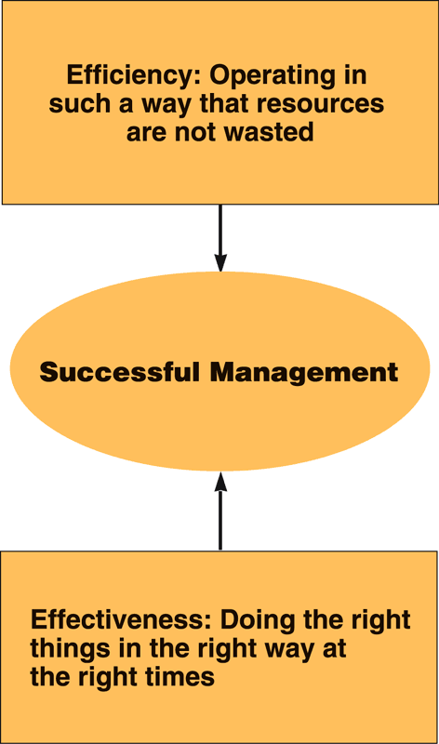
Efficiency versus Effectiveness
Source: Van Fleet, David D., Contemporary Management, Second Edition. Copyright © 1991 by Houghton Mifflin Company. Used with permissions.

Slide 17
What is a Manager?
According to Ricky W. Griffin:
Someone whose primary responsibility is to carry out the management process.
Someone who plans and makes decisions, organizes, leads, and controls human, financial, physical, and information resources.
Notes:
Managers are individuals who are responsible for planning and decision making, organizing, leading, and controlling the resources of a group or organization.

Slide 18
Manager
An individual who is in charge of a certain group of tasks, or a certain subset of a company. A manager often has a staff of people who report to him or her.
As an example, a restaurant will often have a front-of-house manager who helps the patrons, and supervises the hosts; or
a specific office project can have a manager, known simply as the project manager.
Certain departments within a company designate their managers to be line managers, while others are known as staff managers, depending upon the function of the department.

Slide 19
Kinds of Managers by Level and Area
Levels of Management
Top managers
Middle managers
First-line managers
Marketing
Finance
Operations
Other
Human resources
Administration
Areas of Management
Figure 1.1

Slide 20
Kinds of Managers by Level
Top Managers
The relatively small group of executives who manage the organization’s overall goals, strategy, and operating policies.
Middle Managers
Largest group of managers in organizations who are primarily responsible for implementing the policies and plans developed by top managers. They supervise and coordinate the activities of lower-level managers.
First-Line Managers
Managers who supervise and coordinate the activities of operating employees.

Slide 21
Kinds of Managers by Area
Marketing Managers
Work in areas related to getting consumers and clients to buy the organization’s products or services.
Financial Managers
Deal primarily with an organization’s financial resources.
Operations Managers
Concerned with creating and managing the systems that create organization’s products and services.

Slide 22
Kinds of Managers by Area (cont’d)
Human Resource Managers
Involved in human resource planning, recruiting and selection, training and development, designing compensation and benefit systems, formulating performance appraisal systems.
Administrative Managers
Generalists who are familiar with all functional areas of management and who are not associated with any particular management specialty.
Other Kinds of Managers
Specialized managerial positions directly related to the needs of the organization.

Slide 23
Management in Organizations
Planning
and decision
Organizing
making
Inputs from the environment
•
Human resources
Goals attained
•
Financial resources
•
Efficiently
•
Physical resources
•
Effectively
•
Information resources
Controlling
Leading

Slide 24
The Management Process
Planning and
Organizing
Decision Making
Setting the organiza-
Determining how
tion
’
s goals and
best to group
deciding how best
activities and
to achieve them
resources
Controlling
Leading
Monitoring
Motivating members
and correcting
of the organization
ongoing activities
to work in the best
to facilitate goal
interests of the
attainment
organization
Figure 1.2

Slide 25
The Management Process (cont’d)
Planning and Decision Making
Setting an organization’s goals and selecting a course of action from a set of alternatives to achieve them.
Organizing
Determining how activities and resources are grouped.
Leading
The set of processes used to get organizational members to work together to advance the interests of the organization.
Controlling
Monitoring organizational progress towards goals.
Notes:
9
Planning: Setting goals and objectives, developing strategies to achieve them, and creating plans for the use of resources.
Organizing: Coordinating resources, including personnel, finances, and materials, to achieve the goals and objectives.
Leading: Motivating and directing employees to work towards achieving the goals and objectives.
Controlling Monitoring organizational progress towards goals.

Slide 26
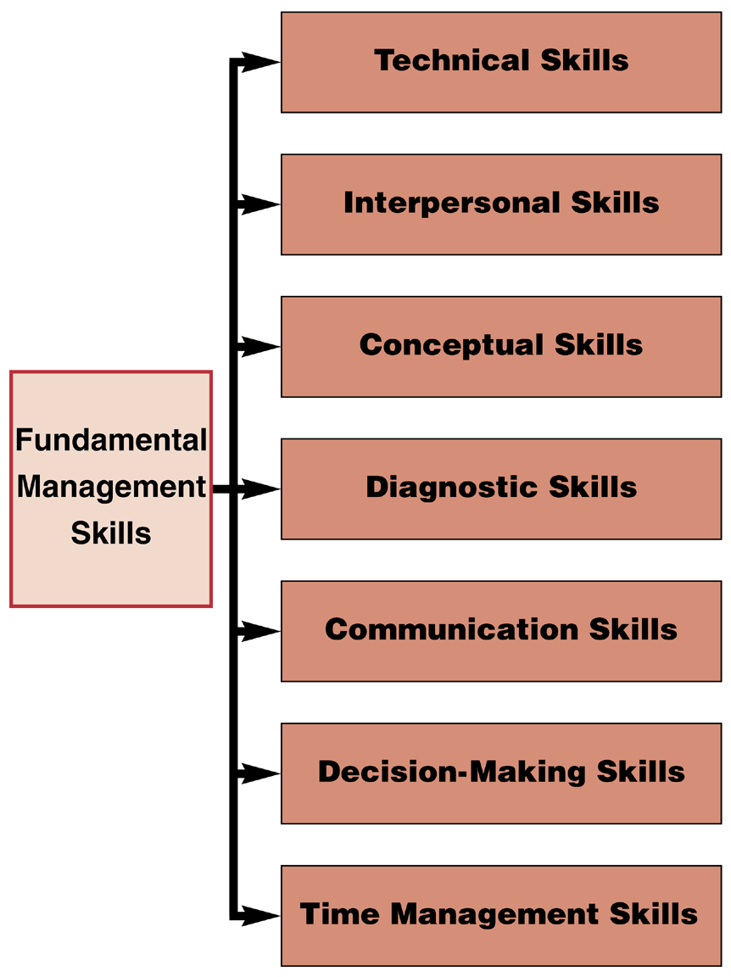
Skills and the Manager

Slide 27
Fundamental Management Skills
Technical
Skills necessary to accomplish or understand the specific kind of work being done in an organization.
Interpersonal
The ability to communicate with, understand, and motivate both individuals and groups.
Conceptual
The manager’s ability to think in the abstract.
Diagnostic
The manager’s ability to visualize the most appropriate response to a situation.
Notes:
17

Slide 28
Fundamental Management Skills (cont’d)
Communication
The manager’s abilities both to convey ideas and information effectively to others and to receive ideas and information effectively from others.
Decision-Making
The manager’s ability to recognize and define problems and opportunities correctly and then to select an appropriate course of action to solve the problems and capitalize on opportunities.
Time-Management
The manager’s ability to prioritize work, to work efficiently, and to delegate appropriately.
Notes:
17

Slide 29
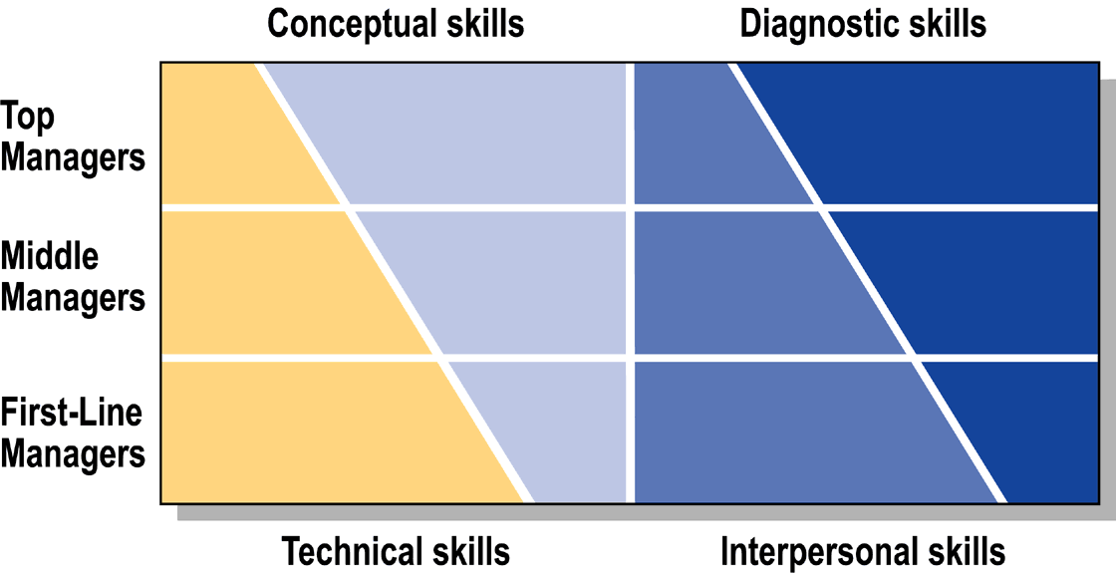
Fundamental Management Skills
Management Skill Mixes at Different Organizational Levels

Slide 30
Management: Science or Art?
The Science of Management
Assumes that problems can be approached using rational, logical, objective, and systematic ways.
Requires technical, diagnostic, and decision-making skills and techniques to solve problems.
The Art of Management
Decisions are made and problems solved using a blend of intuition, experience, instinct, and personal insights.
Requires conceptual, communication, interpersonal, and time-management skills to accomplish the tasks associated with managerial activities.
Notes:
18

Slide 31
The Importance of Theory and History
Why Theory?
A theory is a conceptual framework for organizing knowledge and providing a blueprint for action.
Management theories, used to build organizations, are grounded in reality. Most managers develop their own theories about how they should run their organizations.
Why History?
An awareness and understanding of important historical developments in management are also important to contemporary managers in furthering the development of management practices and in avoiding the mistakes of others in the past.

Slide 32
The Historical Context of Management
Management Through the Ages
D
Greeks
C
Babylonians
G
Venetians
B
Egyptians
E
Romans
A
Sumerians
F
Chinese
3000
B.C.
2500
B.C.
2000
B.C.
1500
B.C.
1000
B.C.
500
B.C.
A.D.
500
A.D.
1000
A.D.
1500
A
Used written rules and regulations for governance
E
Used organized structure for communication and control
B
Used management practices to construct pyramids
F
Used extensive organization structure for government
C
Used extensive set of laws and policies for governance
agencies and the arts
D
Used different governing systems for cities and state
G
Used organization design and planning concepts to
control the seas

Slide 33
Early Management Pioneers
Robert Owen (1771–1858)
British industrialist who was one of the first managers to recognize the importance of human resources and the welfare of workers.
Charles Babbage (1792–1871)
English mathematician who focused on creating efficiencies of production through the division of labor, and the application of mathematics to management problems.
Notes:
4

Slide 34
An Integrative Framework of Management Perspectives
Systems Approach
Contingency Perspective
•
Recognition
of internal
•
Recognition
of the situational
interdependencies
nature of management
•
Recognition of
•
Response to particular
environmental influences
characteristics of situation
Classical
Behavioral
Quantitative
Management
Management
Management
Perspectives
Perspectives
Perspectives
Methods for
Insights for moti-
Techniques for
enhancing
vating performance
improving decision
efficiency and
and understanding
making, resource
facilitating planning,
individual behavior,
allocation, and
organizing, and
groups and teams,
operations
controlling
and leadership
Effective and efficient management

Slide 35
Classical Management Perspective
Scientific Management
Concerned with improving the performance of individual workers (i.e., efficiency).
Grew out of the industrial revolution’s labor shortage at the beginning of the twentieth century.
Administrative Management
A theory that focuses on managing the total organization.
Notes:
5

Slide 36
Scientific Management
Frederick Taylor (1856–1915)
Replaced old methods of how to do work with scientifically-based work methods to eliminate “soldiering,” where employees deliberately worked at a pace slower than their capabilities.
Believed in selecting, training, teaching, and developing workers.
Used time studies of jobs, standards planning, exception rule of management, slide-rules, instruction cards, and piece-work pay systems to control and motivate employees.
Notes:
7

Slide 37
Steps in Scientific Management
1
2
Supervise employees
3
4
Develop a science
Scientifically select
to make sure they
Continue to plan
for each element of
employees and then
follow the prescribed
the work, but use
the job to replace old
train them to do the job
methods for performing
workers to get the
rule-of-thumb methods
as described in step 1
their jobs
work done
Figure 1.3

Slide 38
Scientific Management Pioneers
Frank and Lillian Gilbreth
Both developed techniques and strategies for eliminating inefficiency.
Frank reduced the number of movements in bricklaying, resulting in increased output of 200%.
Lillian made substantive contributions to the fields of industrial psychology and personnel management.
Notes:
9

Slide 39
Classical Management Perspective (cont’d)
Administrative Management Theory
Focuses on managing the whole organization rather than individuals.
Henri Fayol (1845–1925)
Was first to identify the specific management functions of planning, organizing, leading, and controlling.
Lyndall Urwick (1891–1983)
Integrated the work of previous management theorists.
Max Weber (1864–1920)
His theory of bureaucracy is based on a rational set of guidelines for structuring organizations.
Notes:
12

Slide 40
Behavioral Management Perspective
Behavioral Management
Emphasized individual attitudes and behaviors, and group processes, and recognized the importance of behavioral processes in the workplace.
Hugo Munsterberg (1863–1916)
A German psychologist, considered the father of industrial psychology, who advocated the practice of applying psychological concepts to employees selection and motivation industrial settings.
Mary Parker Follett (1868 –1933)
Recognized the importance of the role of human behavior in the workplace.
Notes:
21

Slide 41
The Hawthorne Studies (1927–1932)
Conducted by Elton Mayo and associates at Western Electric
Illumination study—workplace lighting adjustments affected both the control and the experimental groups of production employees.
Group study—implementation of piecework incentive plan caused production workers to establish informal levels of acceptable individual output.
Over-producing workers were labeled “rate busters” and under-producing workers were considered “chiselers.”
Interview program—confirmed the importance of human behavior in the workplace.
Notes:
21

Slide 42
Behavioral Management Perspective (cont’d)
Human Relations Movement
Grew out of the Hawthorne studies.
Proposed that workers respond primarily to the social context of work, including social conditioning, group norms, and interpersonal dynamics.
Assumed that the manager’s concern for workers would lead to increased worker satisfaction and improved worker performance.
Notes:
23

Slide 43
Behavioral Management Perspective (cont’d)
Abraham Maslow
Advanced a theory that employees are motivated by a hierarchy of needs that they seek to satisfy.
Douglas McGregor
Proposed Theory X and Theory Y concepts of managerial beliefs about people and work.
Notes:
23

Slide 44
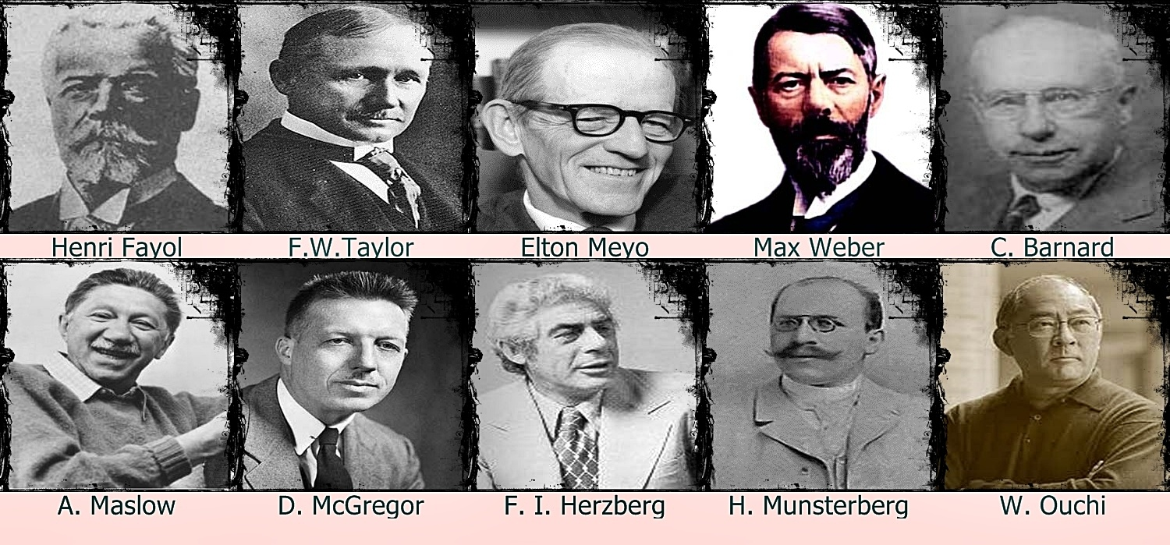

Slide 45
Organizational Behavior
A contemporary field focusing on behavioral perspectives on management.
Draws on psychology, sociology, anthropology, economics, and medicine.
Important topics in organizational behavior research:
Job satisfaction and job stress
Motivation and leadership
Group dynamics and organizational politics
Interpersonal conflict
The structure and design of organizations
Notes:
26

Slide 46
Behavioral Management Perspective…Today
Contributions
Provided important insights into motivation, group dynamics, and other interpersonal processes.
Focused managerial attention on these critical processes.
Challenged the view that employees are tools and furthered the belief that employees are valuable resources.
Notes:
28

Slide 47
Behavioral Management Perspective…Today (cont’d)
Limitations
Complexity of individuals makes behavior difficult to predict.
Many concepts not put to use because managers are reluctant to adopt them.
Contemporary research findings are not often communicated to practicing managers in an understandable form.
Notes:
28

Slide 48
Quantitative Management Perspective
Quantitative Management
Emerged during World War II to help the Allied forces manage logistical problems.
Focuses on decision making, economic effectiveness, mathematical models, and the use of computers to solve quantitative problems.
Notes:
31

Slide 49
Quantitative Management Perspective (cont’d)
Management Science
Focuses on the development of representative mathematical models to assist with decisions.
Operations Management
Practical application of management science to efficiently manage the production and distribution of products and services.
Notes:
31

